Slide 1

Introduction to iCLIP data analysis
Dr. Kathi Zarnack
Buchmann Institute for Molecular Life Sciences (BMLS)
Goethe University Frankfurt, Germany
NCCR / SIB Summer School

Slide 2
The complex life of an mRNA

Slide 3
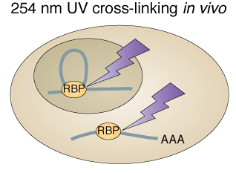
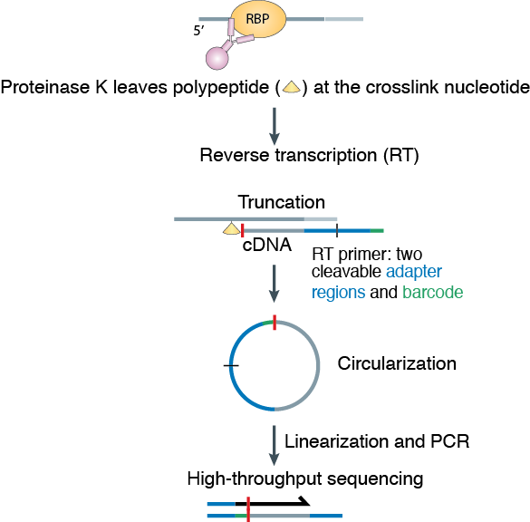
Transcriptome-wide views of protein RNA interactions
iCLIP
= individual-nucleotide resolution UV crosslinking & immunoprecipitation
König, Zarnack et al, Nat Struct Mol Biol, 2010

Slide 4
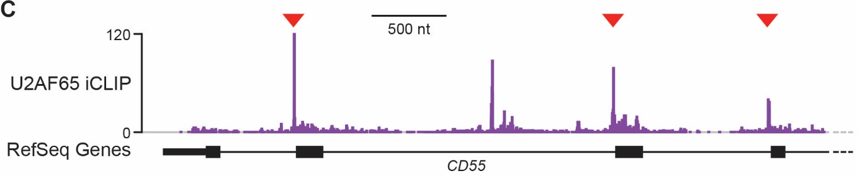
Transcriptome-wide RBP binding patterns
Crosslink profiles show protein-RNA interaction sites
Reflects a mixture of specific binding and background associations

Slide 5
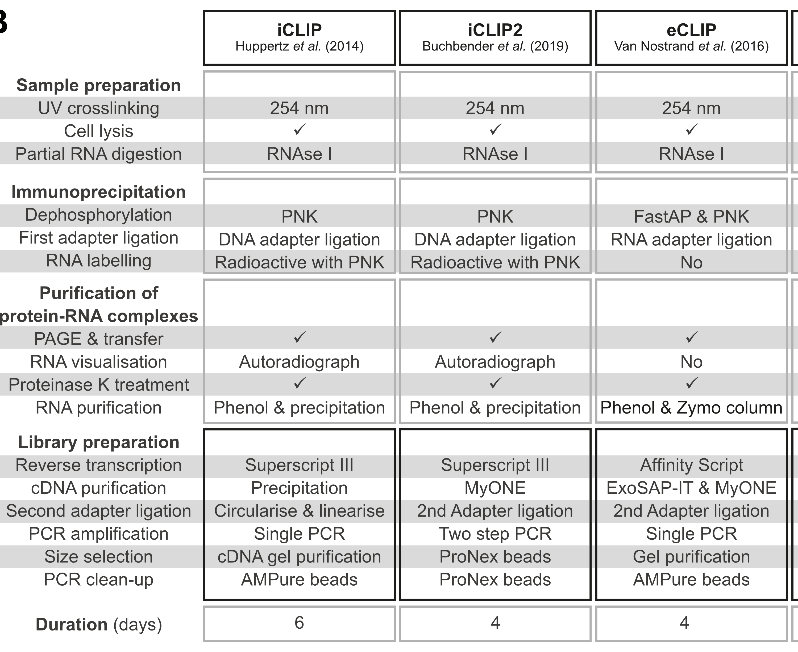
Different flavours of CLIP: iCLIP2 & eCLIP
Buchbender et al, 2020, Methods

Slide 6
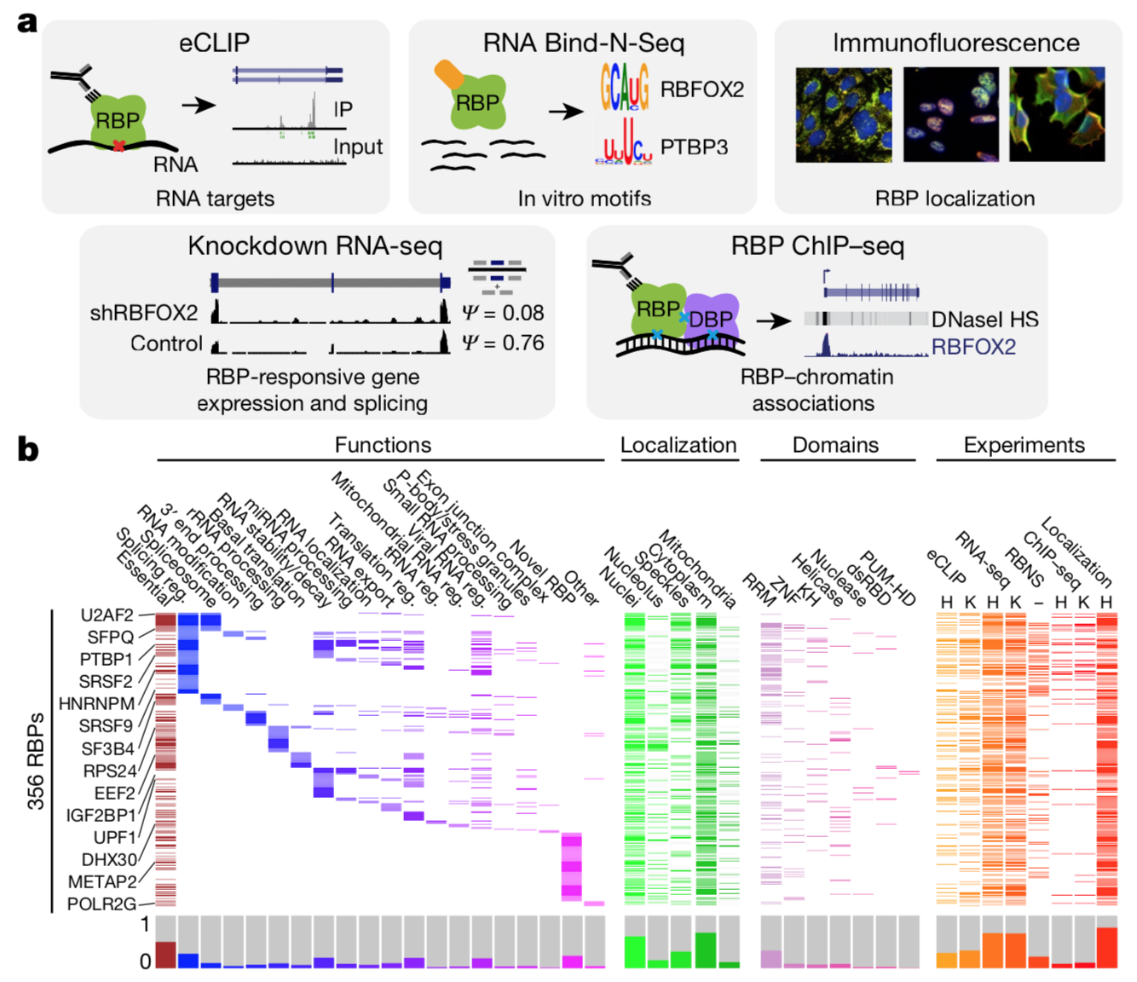
eCLIP data in ENCODE 3
223 eCLIP data sets
for 150 RBPs
in 2 cell lines
Van Nostrand et al, Nature, 2020

Slide 7
The iCLIP data analysis workflow
Step 1: From iCLIP reads to crosslink profiles
QC & filtering
Genomic mapping
Duplicate removal
Step 2: From crosslink events to binding sites
Peak calling
Step 3: Examples for downstream analyses
Assignment to transcript regions
Motif enrichment
Positional maps

Slide 8
Data analysis workflow
Step 1: From iCLIP reads to crosslink profiles
QC & filtering
Genomic mapping
Duplicate removal
Step 2: From crosslink events to binding sites
Peak calling
Step 3: Examples for downstream analyses
Assignment to transcript regions
Motif enrichment
Positional maps

Slide 9
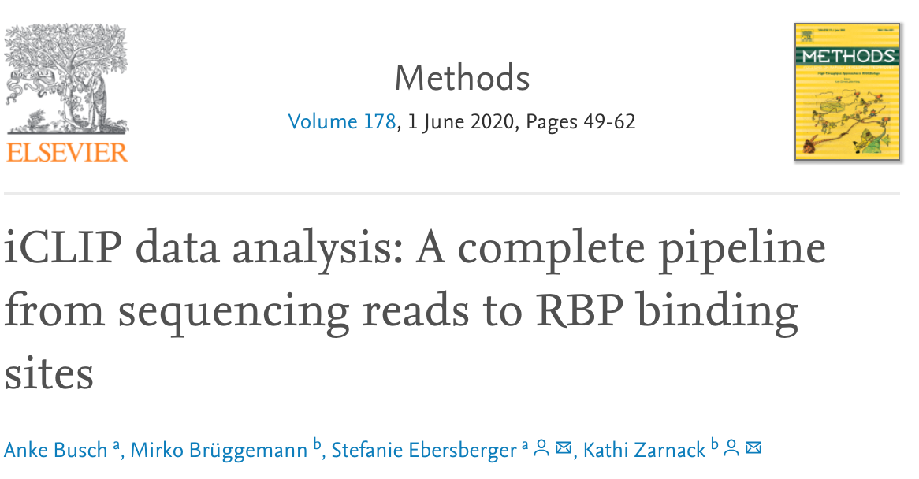
Data analysis workflow
Busch et al, 2020, Methods 178: 49-62.

Slide 10
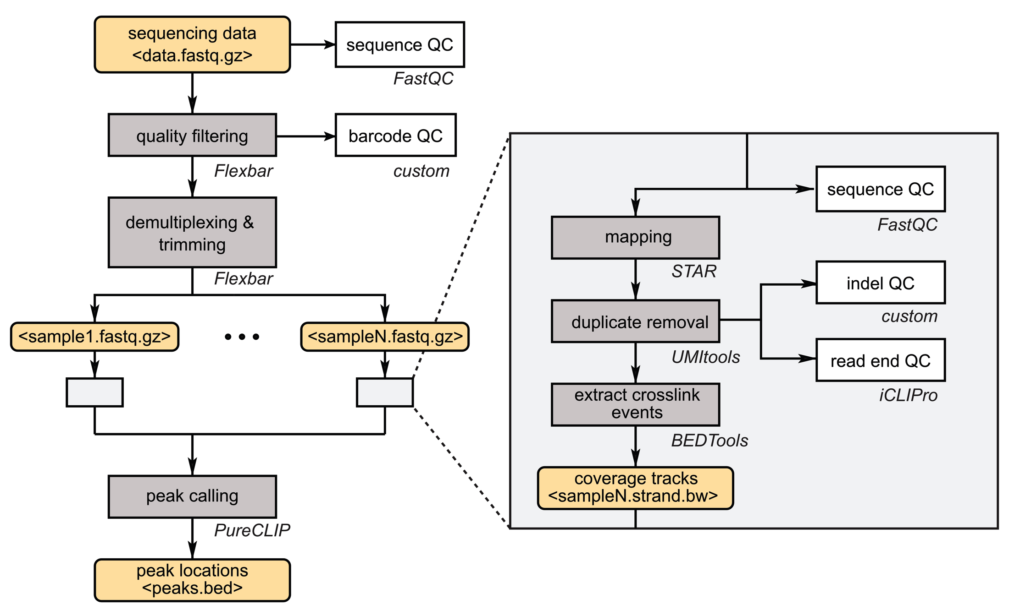
Data analysis workflow
Busch et al, 2020, Methods 178: 49-62.

Slide 11
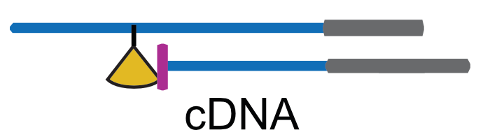
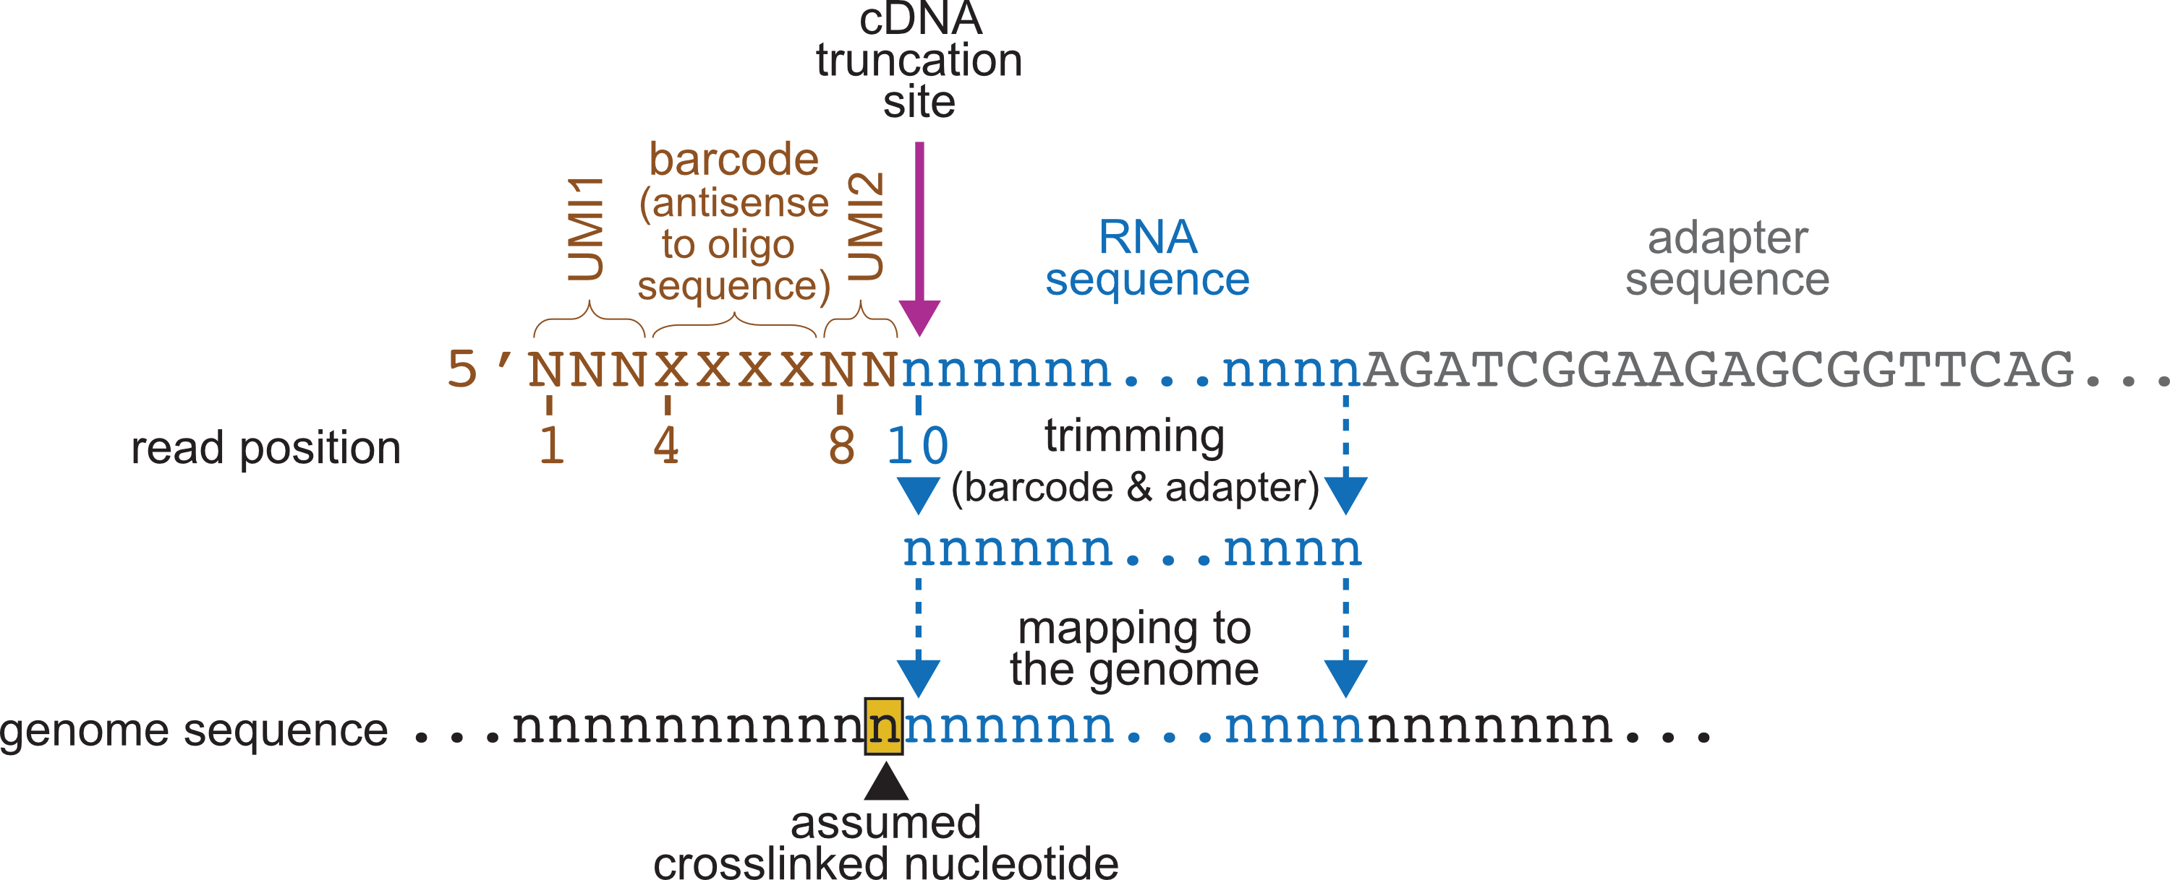
iCLIP read structure
Reads consist of cDNA fragment and barcodes
Experimental barcode & UMI
9-nt in iCLIP
(15-nt in iCLIP2)
Busch et al, 2020, Methods 178: 49-62.

Slide 12
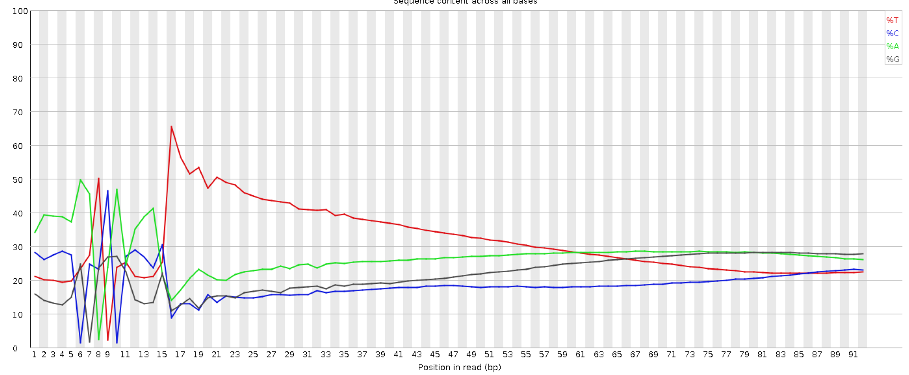
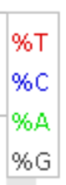
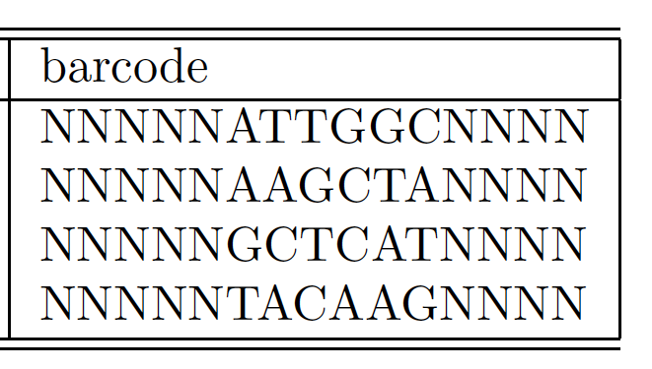
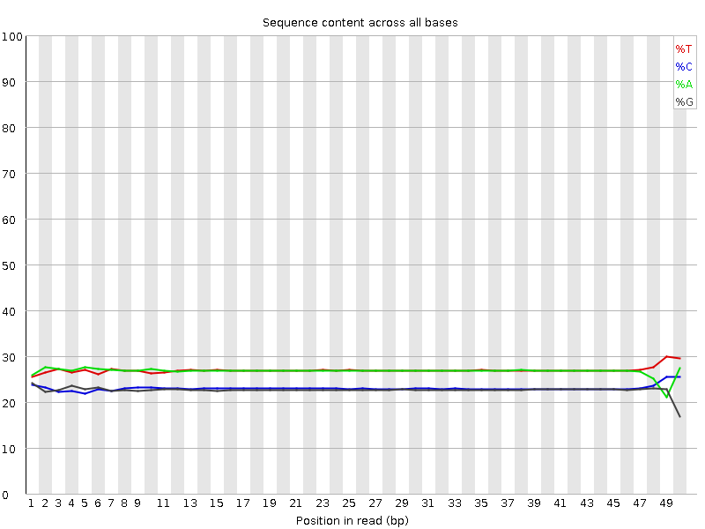
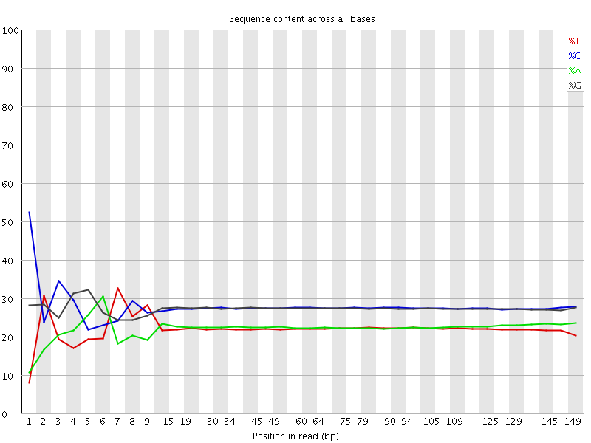
General quality control (FastQC)
Sequence composition per cycle (“Per base sequence content”)
iCLIP
DNA-seq
RNA-seq

Slide 13
Adapter trimming & demultiplexing (Flexbar)
5’ adapter
Removal of barcodes (fixed length)
9-nt in iCLIP (15-nt in iCLIP2)
> cut off and append to read name in fastq file

Slide 14
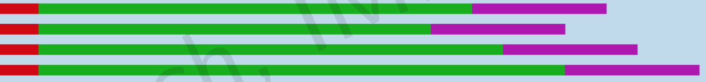
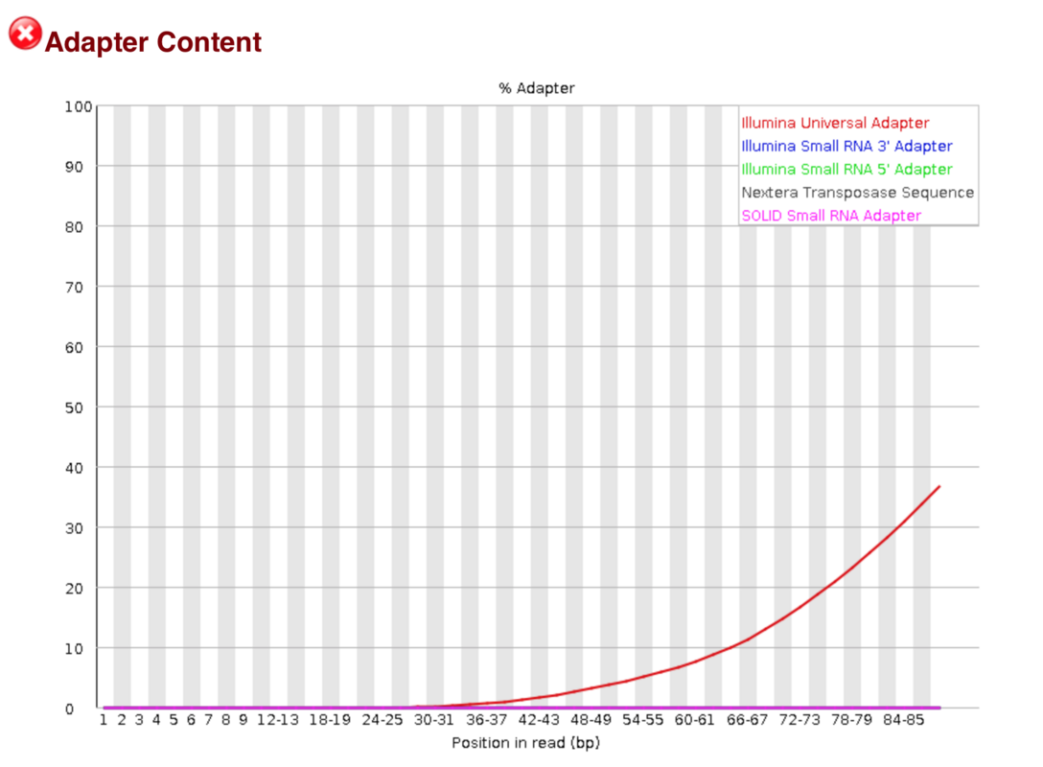
Adapter trimming & demultiplexing (Flexbar)
3’ adapter
Variable trimming depending on sequence
Sequencing length
Parameters to consider:
--adapter-min-overlap 1 with a low value, the adapter can be better detected at the end of reads.
--adapter-error-rate allows for sequencing errors in the adapter; should be set according to the adapter length.

Slide 15
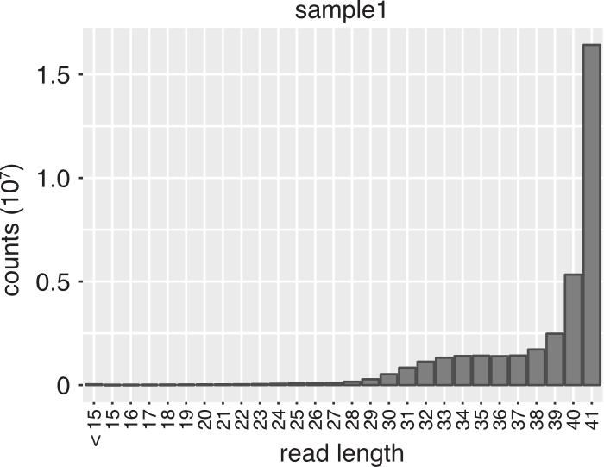
Adapter trimming & demultiplexing (Flexbar)
Remaining read length = length distribution of co-purified RNA fragments
Haberman et al, 2017, Genome Biol

Slide 16
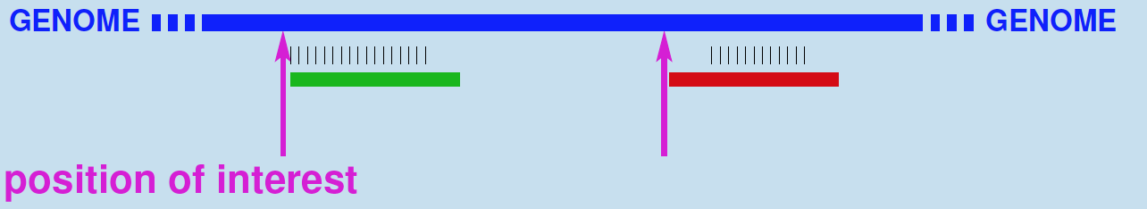
Genomic mapping (STAR)
Attention: No softclipping at 5’ end!
Parameters to consider:
--alignEndsType Extend5pOfRead1 = allows softclipping only at 3’ end
(default: local)

Slide 17
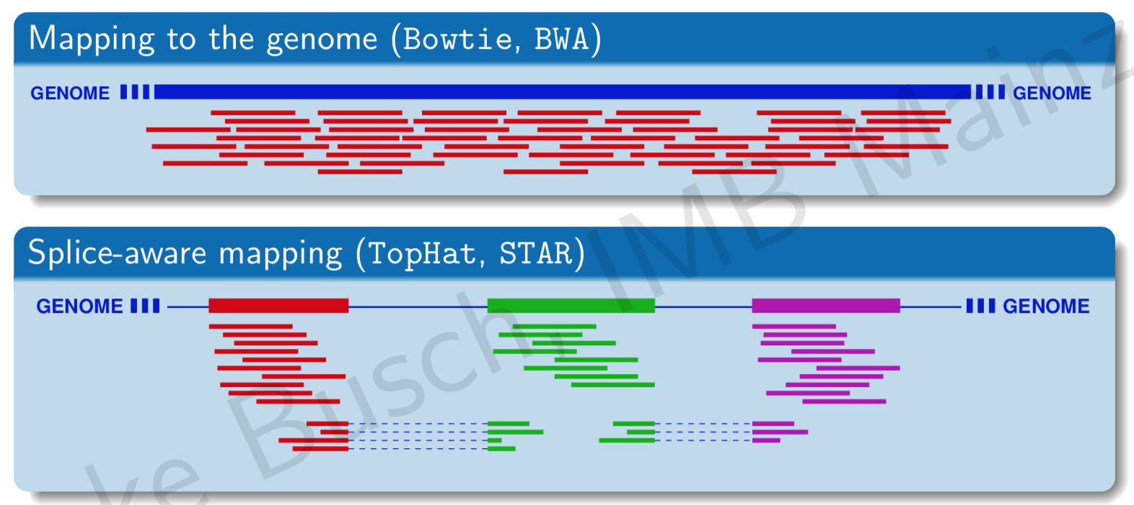
Genomic mapping (STAR)
Parameters to consider:
--outFilterMultimapNmax 1 = only uniquely mapping reads
--outFilterMismatchNoverLmax 0.04 = fraction of mismatches over mapped read length
--outFilterMismatchNmax 999 = absolute number of mismatches

Slide 18
Removal of PCR duplicates (UMItools)
GAA
> > > > > > > > > > > > > > > > > > > > > > > > > > > > > > > > > > > > > >
UMI
read
TAT
> > > > > > > > > > > > > > > > > > > > > > > > > > > > > > > > > > > > > > > > >
TAT
> > > > > > > > > > > > > > > > > > > > > > > > > > > > > > > > > > > > > > > > > >
TAT
> > > > > > > > > > > > > > > > > > > > > > > > > > > > > > > > > > > > > > > > > >
TAT
> > > > > > > > > > > > > > > > > > > > > > > > > > > > > > > > > > > > > > > > > >
reads mapped to reference genome
TAT
> > > > > > > > > > > > > > > > > > > > > > > > > > > > > > > > > > > > > > > > > >
CTG
> > > > > > > > > > > > > > > > > > > > > > >
GAA
> > > > > > > > > > > > > > > > > > > > > > > > > > > > > > > > > > > > > >
TAT
> > > > > > > > > > > > > > > > > > > > > > >
CTC
> > > > > > > > > > > > > > > > > > > > > > > > > > > > > > > > > > >
CTC
> > > > > > > > > > > > > > > > > > > > > > > > > > > > > > > > > > >
TAT
> > > > > > > > > > > > > > > > > > > > > > > > > > > > > > > > > > > > > > > > > > > > > > > > > >
AAC
> > > > > > > > > > > > > > > > > > > > > > > > > > > > > > > > > > > > > > > > > > > > > > > > > >
genome
ACT
> > > > > > > > > > > > > > > > > > > > > > > > > > > > > > > >
read
count
5
4
3
2
1
5
5
1
5
1
2
crosslink events
5
4
3
2
1
4
1
1
1
2

Slide 19
Removal of PCR duplicates (UMItools)
GAA
> > > > > > > > > > > > > > > > > > > > > > > > > > > > > > > > > > > > > >
UMI
read
TAT
> > > > > > > > > > > > > > > > > > > > > > > > > > > > > > > > > > > > > > > > >
TAT
> > > > > > > > > > > > > > > > > > > > > > > > > > > > > > > > > > > > > > > > > >
TAT
> > > > > > > > > > > > > > > > > > > > > > > > > > > > > > > > > > > > > > > > > >
TAT
> > > > > > > > > > > > > > > > > > > > > > > > > > > > > > > > > > > > > > > > > >
reads mapped to reference genome
TAT
> > > > > > > > > > > > > > > > > > > > > > > > > > > > > > > > > > > > > > > > > >
CTG
> > > > > > > > > > > > > > > > > > > > > > >
GAA
> > > > > > > > > > > > > > > > > > > > > > > > > > > > > > > > > > > > > >
TAT
> > > > > > > > > > > > > > > > > > > > > > >
CTC
> > > > > > > > > > > > > > > > > > > > > > > > > > > > > > > > > > >
CTC
> > > > > > > > > > > > > > > > > > > > > > > > > > > > > > > > > > >
TAT
> > > > > > > > > > > > > > > > > > > > > > > > > > > > > > > > > > > > > > > > > > > > > > > > > >
AAC
> > > > > > > > > > > > > > > > > > > > > > > > > > > > > > > > > > > > > > > > > > > > > > > > > >
genome
ACT
> > > > > > > > > > > > > > > > > > > > > > > > > > > > > > > >
read
count
5
4
3
2
1
5
5
1
5
1
2
crosslink events
5
4
3
2
1
4
1
1
1
2

Slide 20
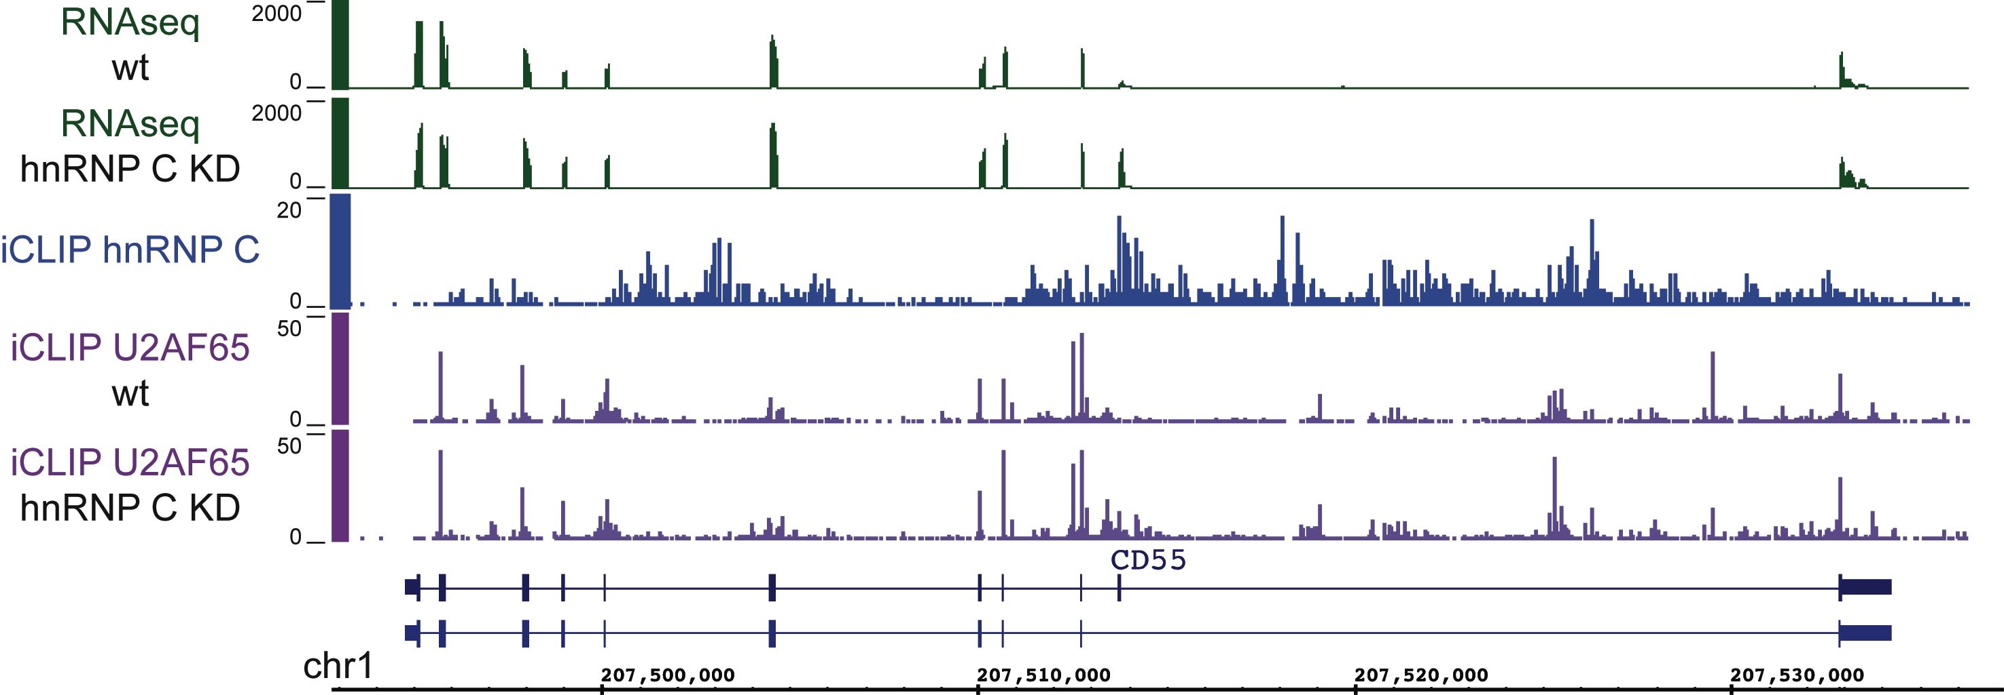
Data visualisation (IGV)
RBP crosslink profile
bigWig format

Slide 21

Our workflow
Step 1: From iCLIP reads to crosslink profiles
QC & filtering
Genomic mapping
Duplicate removal
Step 2: From crosslink events to binding sites
Peak calling
Step 3: Examples for downstream analyses
Assignment to transcript regions
Motif enrichment
Positional maps

Slide 22
Our workflow
Step 1: From iCLIP reads to crosslink profiles
QC & filtering
Genomic mapping
Duplicate removal
Step 2: From crosslink events to binding sites
Peak calling
Step 3: Examples for downstream analyses
Assignment to transcript regions
Motif enrichment
Positional maps

Slide 23
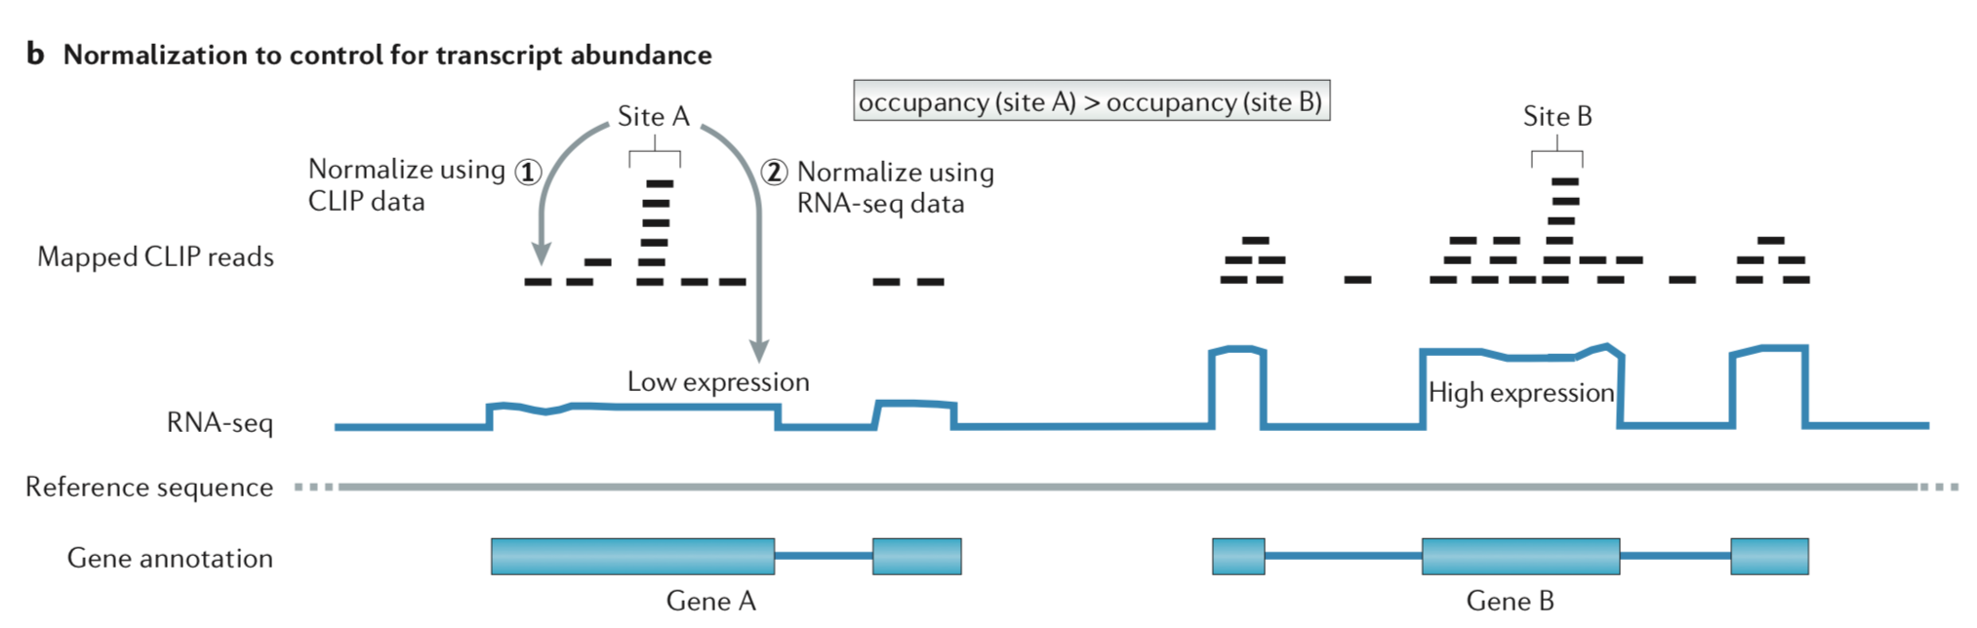
Correction for transcript abundance
König et al, 2012, Nat Rev Genet

Slide 24
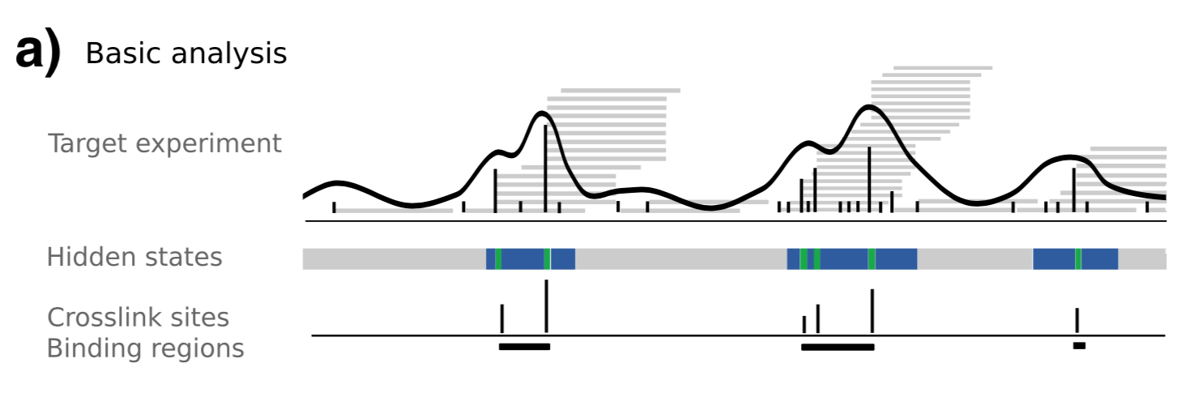
Peak calling (PureCLIP)
Hidden Markov Model on read densities and truncation sites
corrects for transcript abundance
applicable to iCLIP & eCLIP data
Krakau et al, 2017, Genome Biol

Slide 25
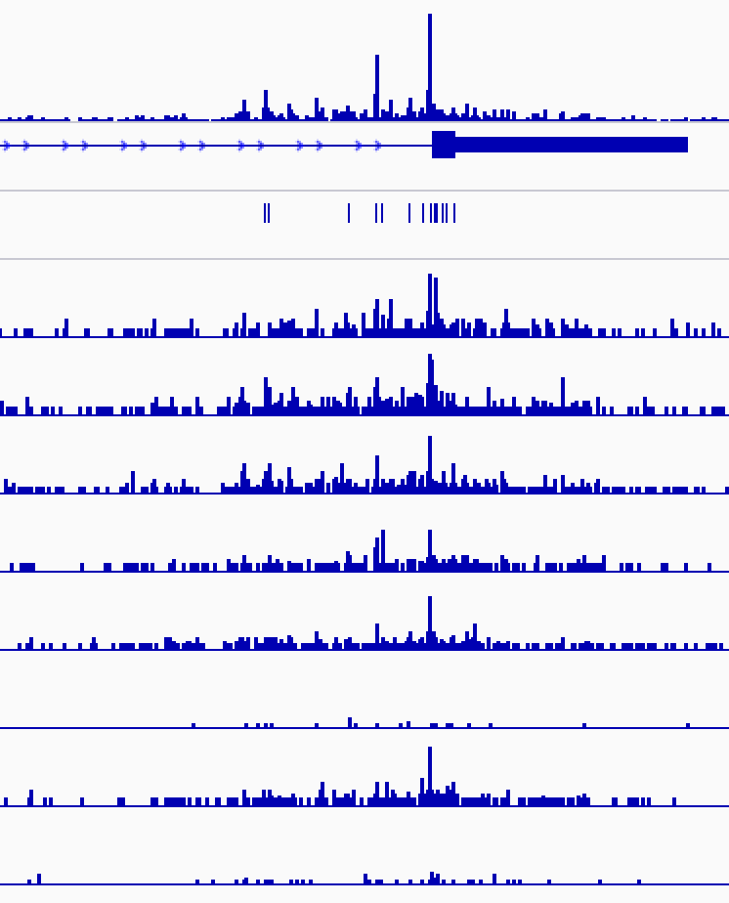
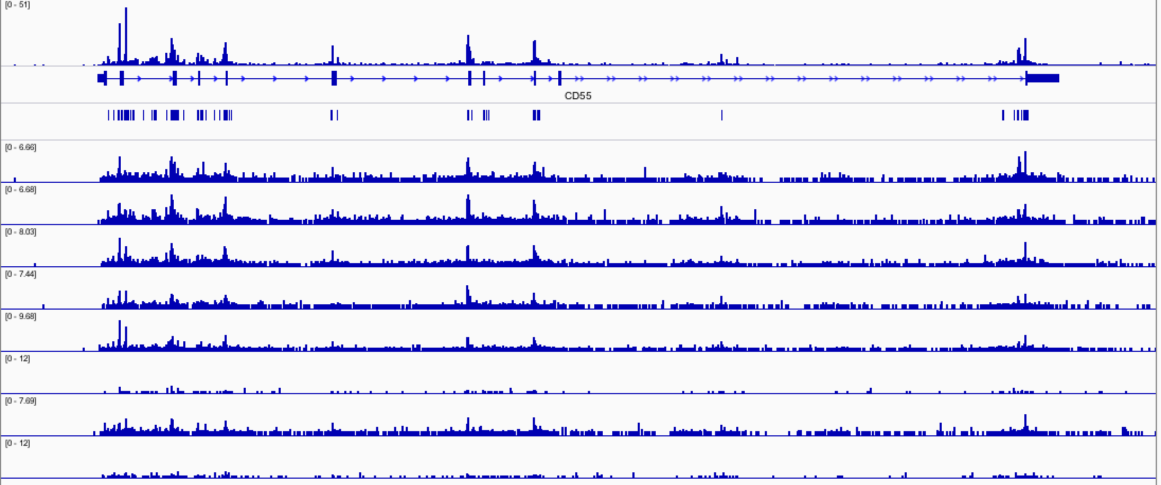
Merging the input data
Merge replicates to increase signal-to-noise ratio

Slide 26
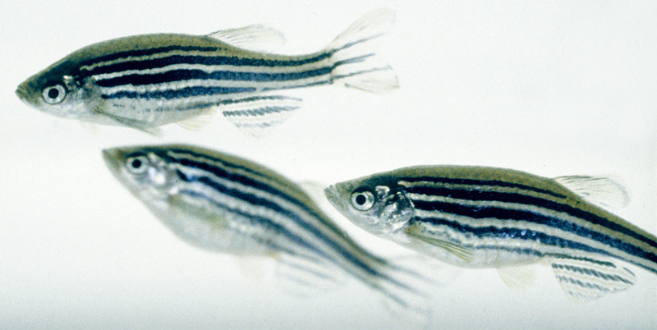


Sources of variation
Biological variability
intrinsic to the studied organisms
Technical variability
arises from experiment
Stochastic noise
random, cannot be avoided

Slide 27
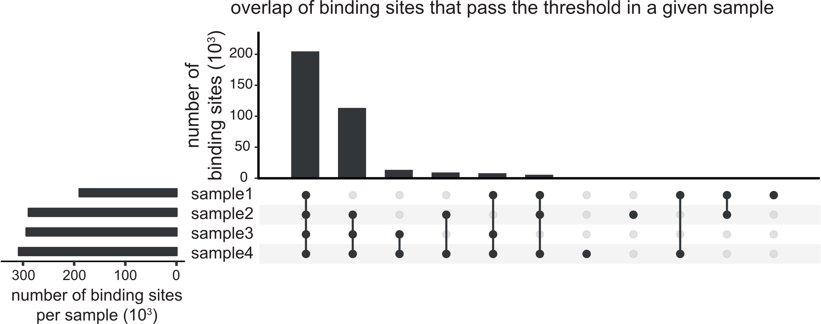
Reproducibility between replicates (custom)
Count crosslink events into binding sites

Slide 28
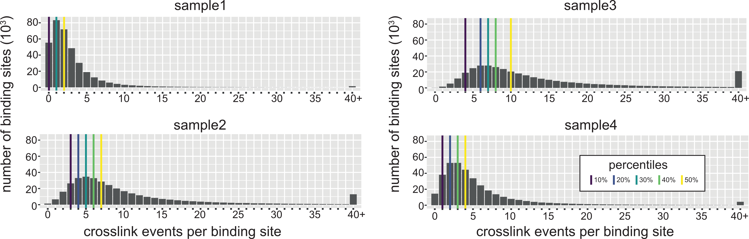
Reproducibility between replicates (custom)
Count crosslink events into binding sites
Dynamic threshold depending on sample depth

Slide 29
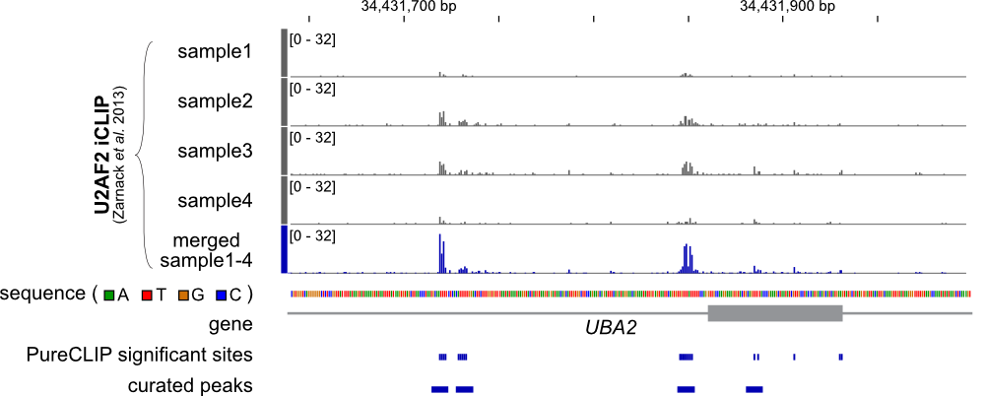
From PureCLIP calls to binding sites
Final outcome: equal-sized binding sites

Slide 30
Our workflow
Step 1: From iCLIP reads to crosslink profiles
QC & filtering
Genomic mapping
Duplicate removal
Step 2: From crosslink events to binding sites
Peak calling
Step 3: Examples for downstream analyses
Assignment to transcript regions
Motif enrichment
Positional maps

Slide 31
Our workflow
Step 1: From iCLIP reads to crosslink profiles
QC & filtering
Genomic mapping
Duplicate removal
Step 2: From crosslink events to binding sites
Peak calling
Step 3: Examples for downstream analyses
Assignment to transcript regions
Motif enrichment
Positional maps

Slide 32
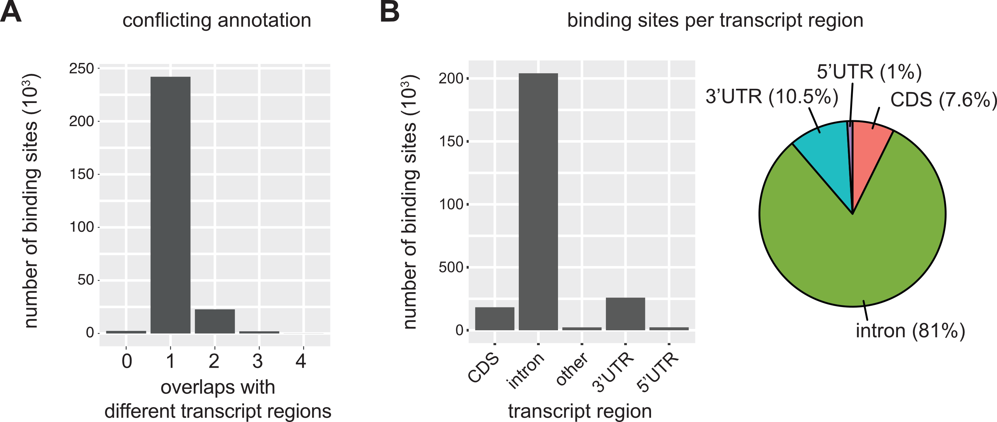
Assignment to genes and transcript regions
Choice of different annotation files (RefSeq, GENCODE, UCSC)
Strategies to resolve overlapping annotations (filter annotation, prior knowledge, hierarchy)

Slide 33
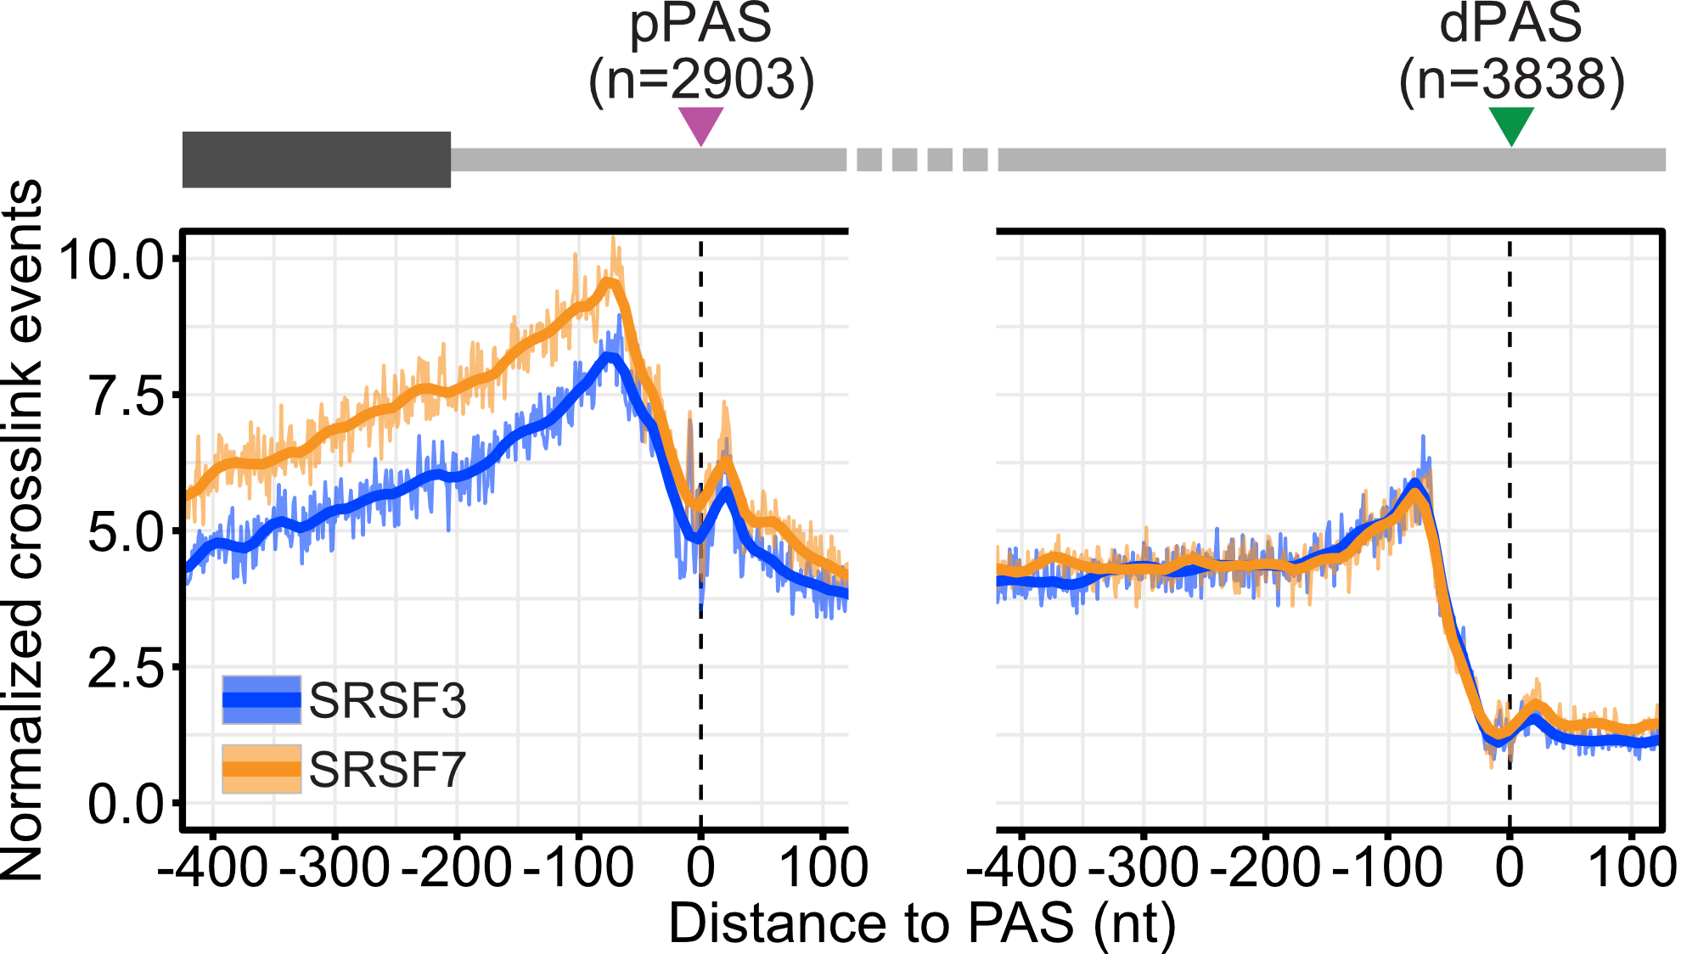
Relative RBP binding profiles (RNAmap)
Meta-profile = alignment of regions on landmark site
Sum of crosslink events over aligned regions

Slide 34
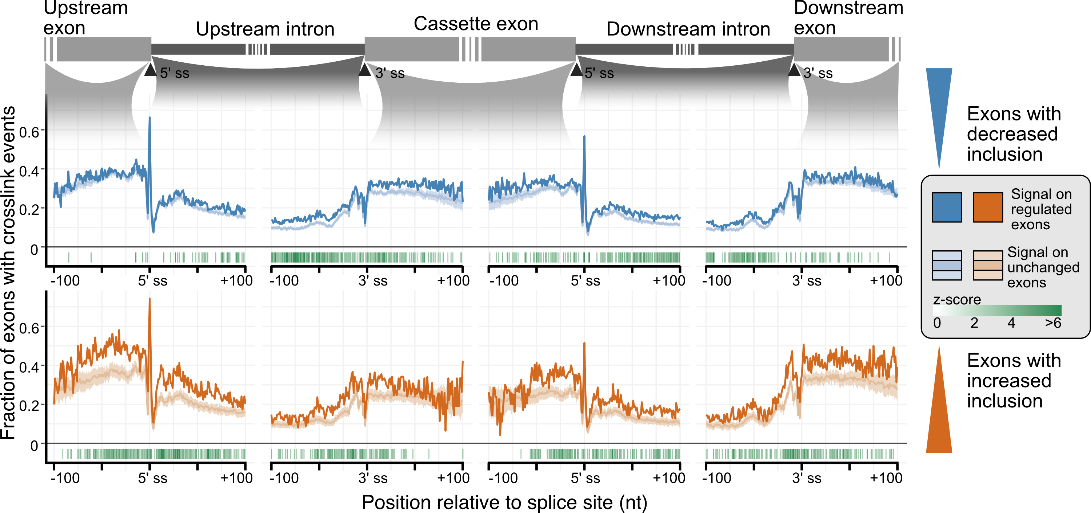
Relative RBP binding profiles (RNAmap)
Meta-profile = alignment of regions on landmark site
Sum of crosslink events over aligned regions

Slide 35
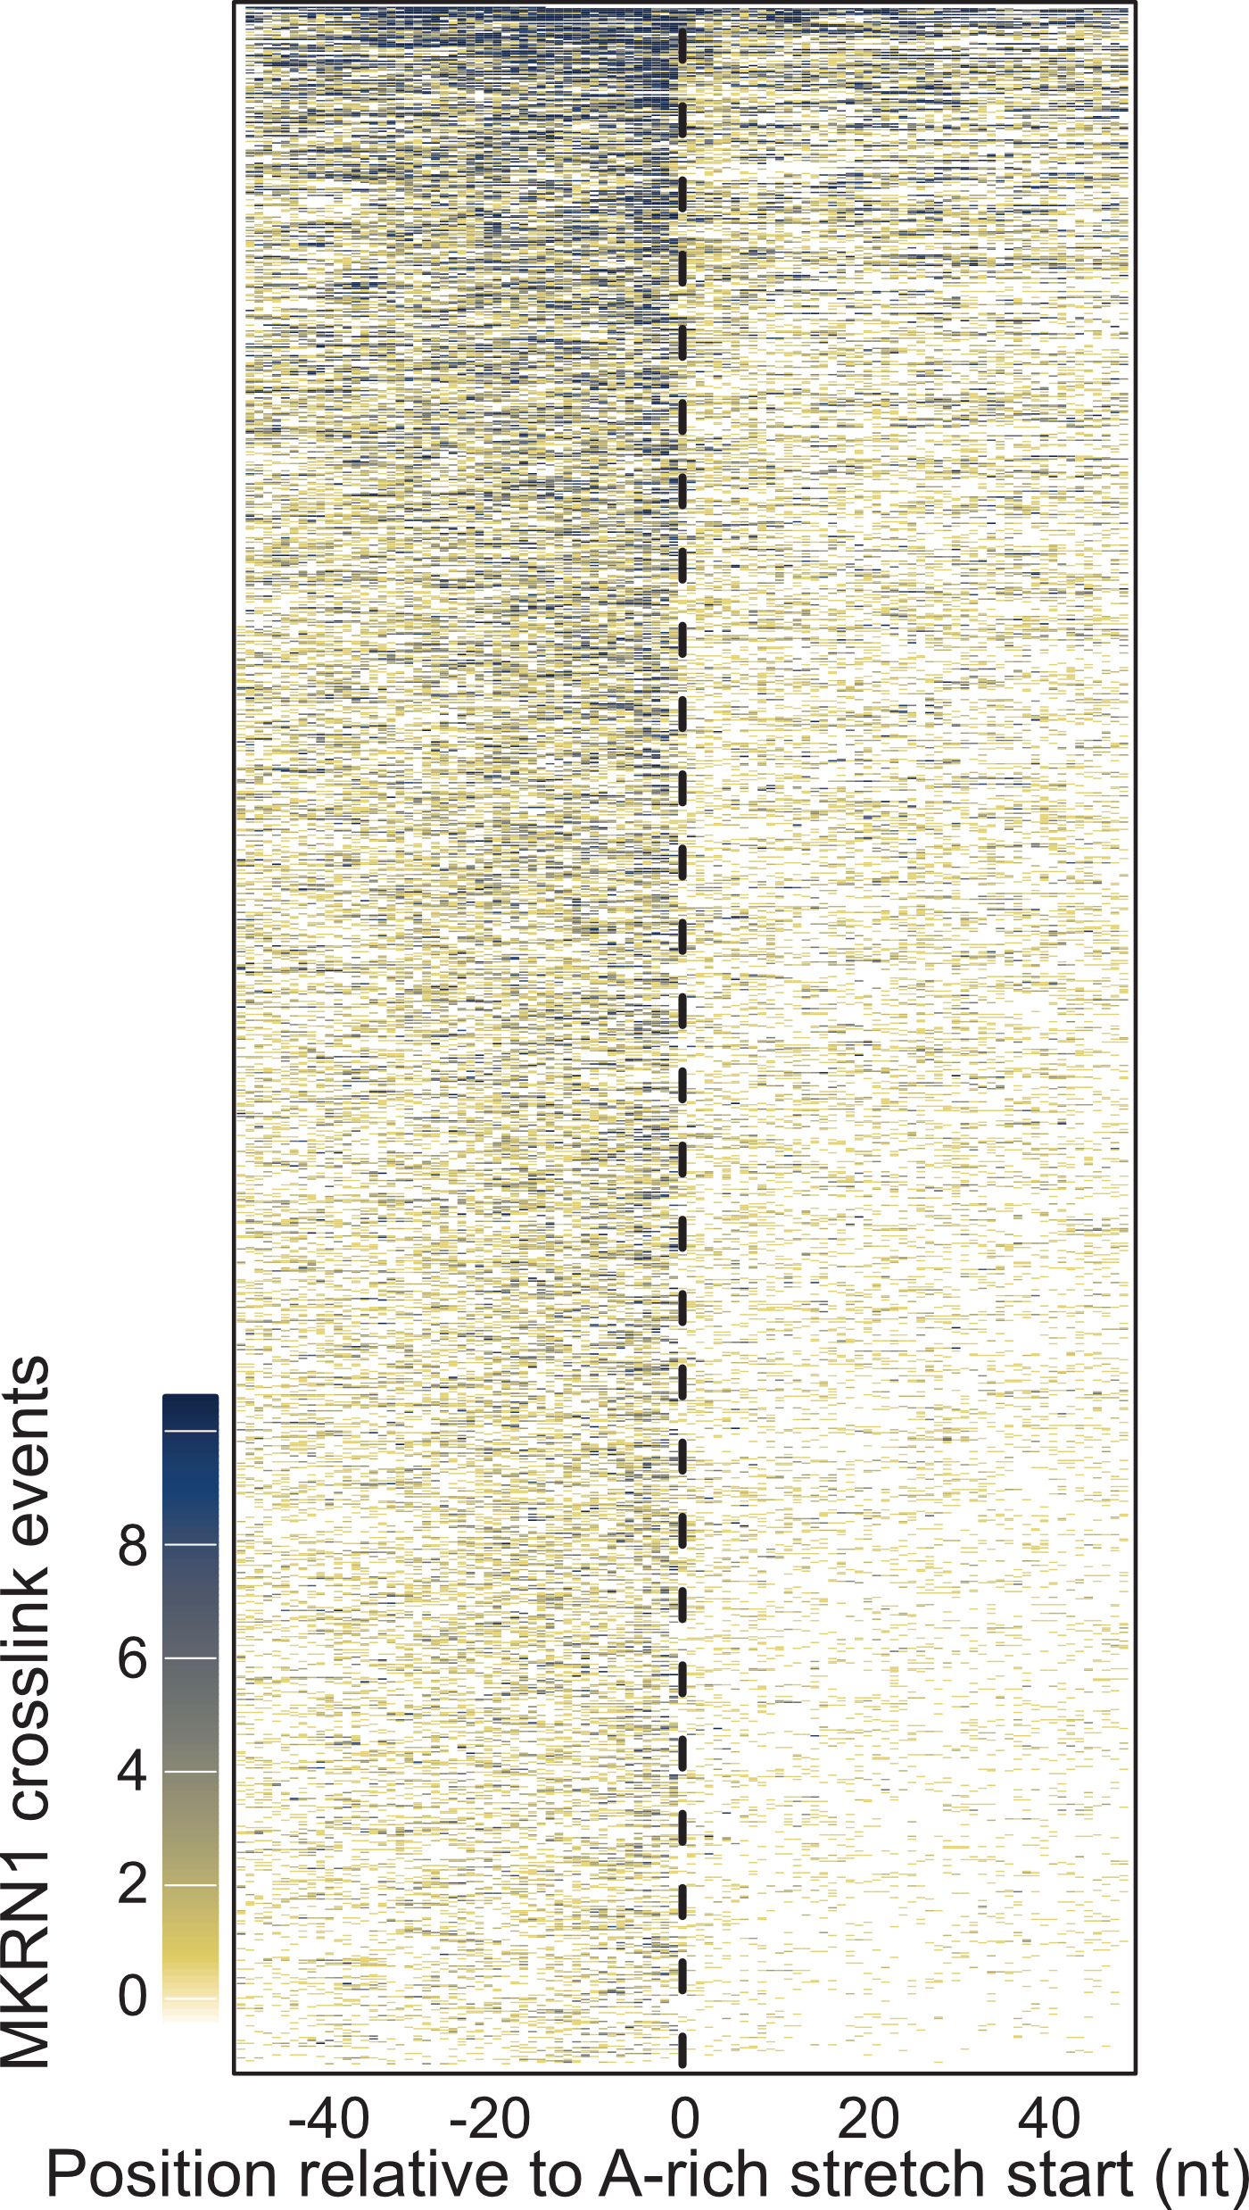
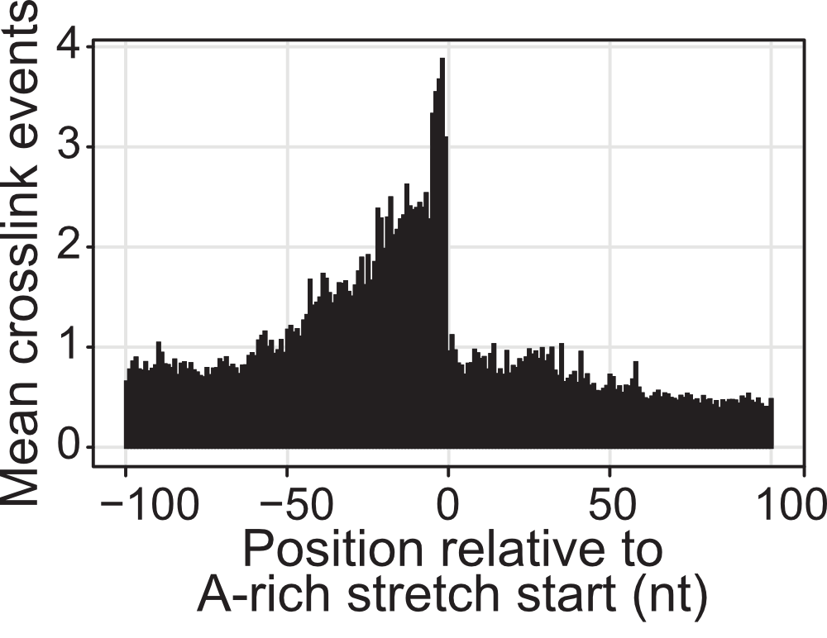
Relative RBP binding profiles (RNAmap)
BUT: metaprofiles can conceal binding patterns
Heatmap representation

Slide 36
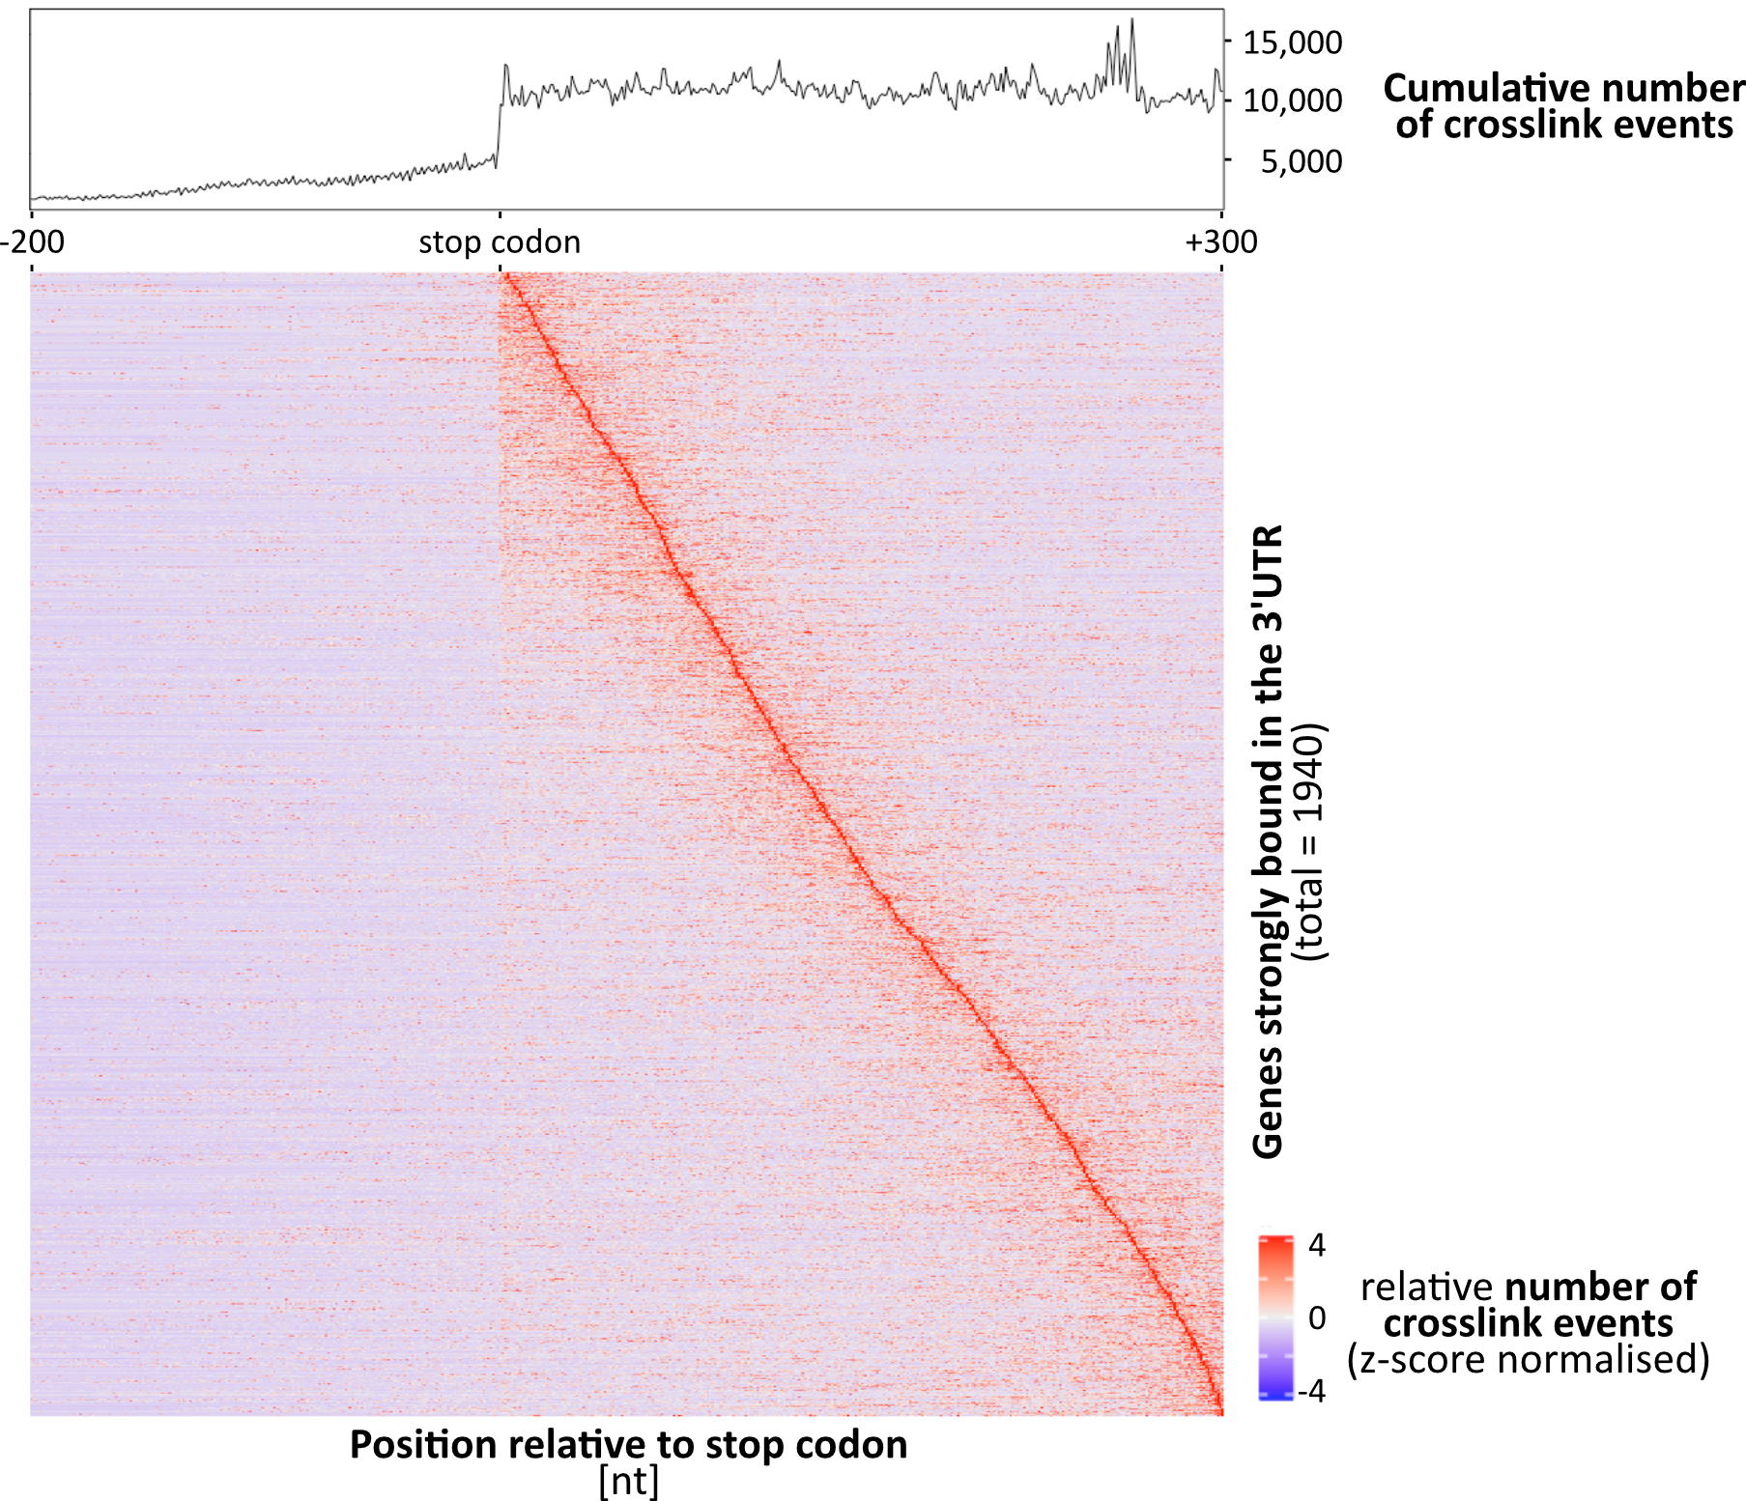
Relative RBP binding profiles (RNAmap)

Slide 37
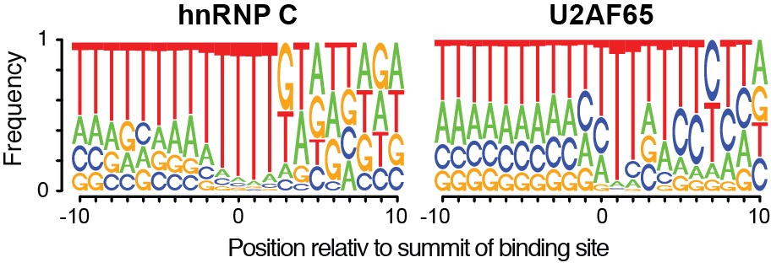
Sequence composition at binding sites
Graphical representation of multiple sequence alignments
Richer representation than e.g. a consensus sequence
Height of each symbol reflects positional frequency
Weblogos: http://weblogo.berkeley.edu/logo.cgi
EMBO Practical Course on iCLIP
31.03.2017

Slide 38
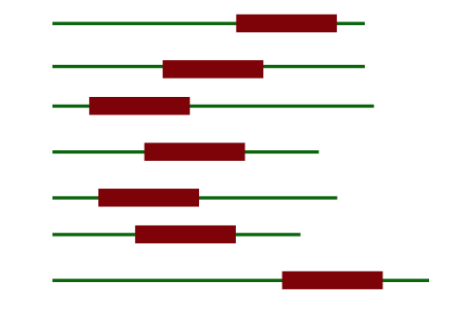
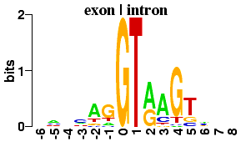
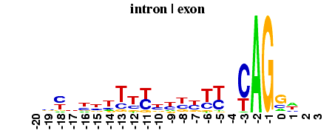
Motif enrichment analysis
MEME /DREME
Motif enrichment over background
One or more occurrences
For RNA: Search given strand only
Position weight matrix (PWM) or position-specific scoring matrix (PSSM)
Human splice sites

Slide 39
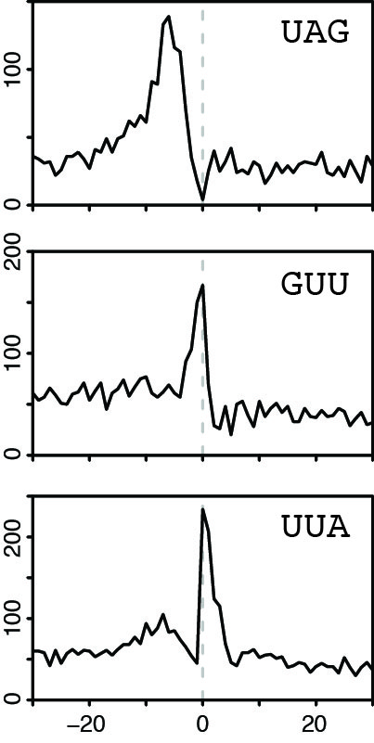
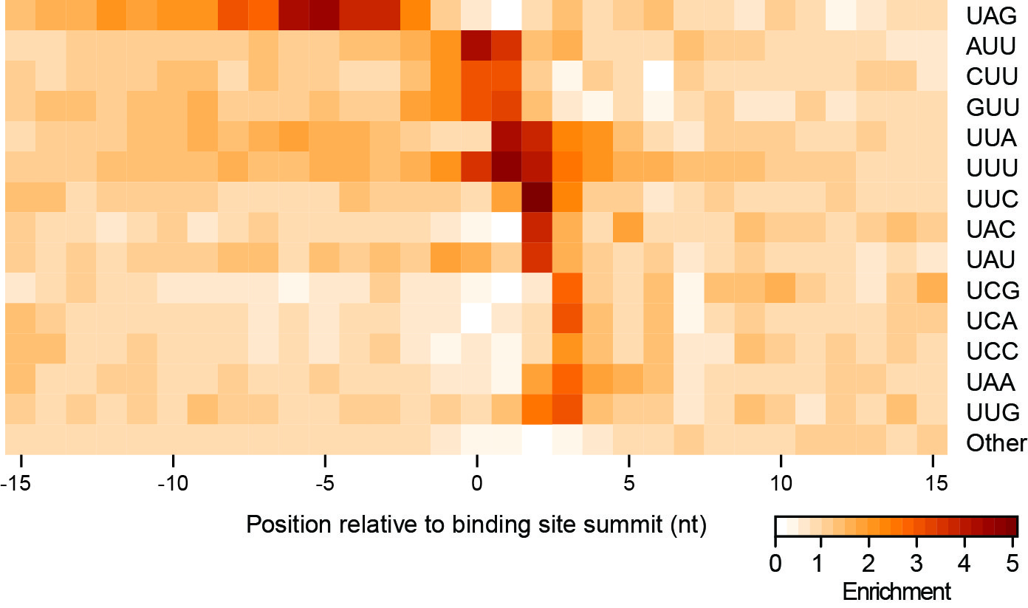
Sequence composition around binding sites
k-mer profiles
Positional enrichment of binding motifs
Position relative to binding site [nt]

Slide 40
Summary – CLIP data analysis
CLIP-seq offers transcriptome-wide maps
Challenge to extract binding sites from the crosslink profiles
Every RBP is different
Integration with orthogonal data allows to identify functional relationships
eCLIP opens the opportunity to look at dozens of RBPs

